Slide 1
Watumull Institute Of Electronics Engineering And Computer Technology
Music Recommendation System
By Group 10
Tanmay Kulkarni (25)
Pushpak Maind (28)
Rahul Patil (37)
Vishal Shirke (48)
Project Guide:
Prof. Naveen Vaswani

Slide 2
Problem Statement
There are too much songs to choose from.
Most of the systems give recommendations on the same genre or artist.
This lack of variety results in limiting a user to a few selective songs.
Even if listening to music is his/her best hobby. People sometimes feel difficult to choose from millions of songs.
The solution is to use a recommender system which learns from users listening history and features of songs and predicts what users would like to listen.

Slide 3
Proposed System
A music recommendation system which is better and easy to use.
The system will predict songs based on users behavior.
The system will take a song as an input and recommend no. of songs based on users request.
The goal of this recommendation system would be to provide personalized content by rightly identifying what the user wants and save their time.
To achieve this we will use machine learning techniques to make a recommendation model.
This model will be able to suggest songs based on users choices.

Slide 4
Recommendation system
A recommender system, or a recommendation system is a subclass of information filtering system that seeks to predict the "rating" or "preference" a user would give to an item.
Recommender systems usually make use of either or both collaborative filtering and content-based filtering (also known as the personality-based approach)
Recommendation System
Collaborative Filtering
Content-based approach
Hybrid Models

Slide 5
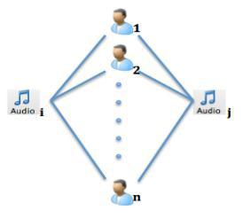
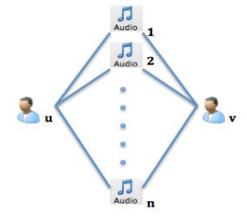
Collaborative Filtering
Collaborative filtering is a method of making predictions (filtering) about the interests of a user by collecting preferences or taste information from many users (collaborating).
Item-Based
User-Based

Slide 6
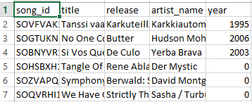
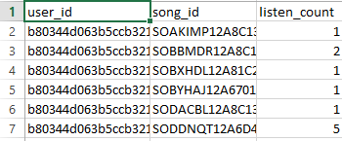
Dataset Info
Features:
Large Scale : 1 million users
½ million songs
Content:
Song Data: (song id, title, release, artist name, year)
Triplet: (user id, song id, listen count)

Slide 7





Building Of Co-occurrence Matrix
Similarity between User songs & All songs(dataset).
Two parameters User songs & All songs are taken.
Co-occurrence matrix =
L(User songs) X L(All songs)
UBCF (User based Collaborative filtering)
1 | 5 | 6 | 3 | 2
2 | 1 | 5 | 8 | 9
10 | 4 | 1 | 5 | 7
4 | 8 | 5 | 1 | 4
7 | 9 | 3 | 2 | 1

Slide 8
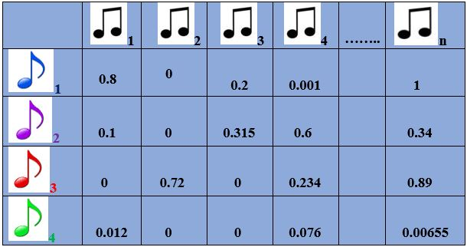

Concept of Jaccard Index
Jaccard Index, a representation of similarities between 2 sample sets.
Two sets here are A & B
where A = all unique listeners of songs provided by user for recommendation
& B = all unique listeners of songs present in dataset All unique songs in dataset
Jaccard Index calculation Songs
given by
formulae: User for
J(A,B) = $\frac{len(A∩B)}{len(AUB)}$ = $\frac{I}{U}$ Recommendation

Slide 9
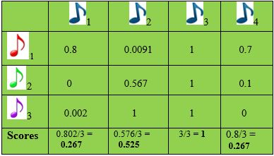
Recommending Top Songs
Scores Calculation: Weighted average method
Scores = Sum of all rows (column wise) / Total no. of rows
If L(I – U) is less then Score is more & hence,
Recommendation is strong! All unique songs in dataset
On the basis of Score, Rank is decided & top
recommendations to the User are given.
(Highest Score = Lowest Rank) User
entered songs

Slide 10
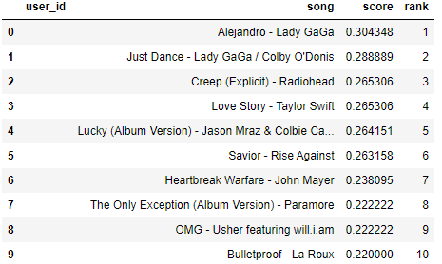
Accuracy
Accuracy is calculated by Consistency of the model.
Accuracy Obtained is 60%.

Slide 11
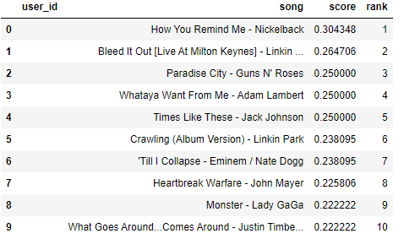
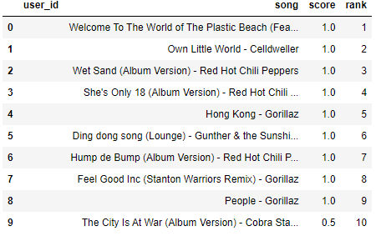
Sample Results

Slide 12
Let’s Proceed to the Demo

